Slide 1
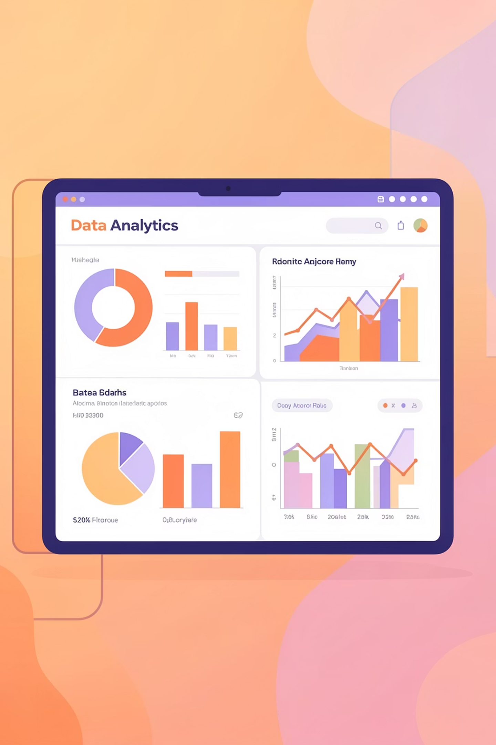
Customer Shopping Behavior Analysis
Uncovering insights from 3,900 purchases to guide strategic business decisions through data-driven analysis of spending patterns, customer segments, and product preferences.

Slide 2
DATASET OVERVIEW
The Foundation: Our Data
3.9K
18
50
25
Total Purchases
Data Features
Locations
Products
Transactions analyzed
Customer and purchase attributes
Geographic coverage
Unique items tracked
Dataset includes customer demographics, purchase details, shopping behavior, and review ratings across four product categories: Clothing, Accessories, Footwear, and Outerwear.

Slide 3

PHASE 1
Data Preparation with Python
01
Data Loading & Exploration
Imported dataset and analyzed structure using pandas
02
Cleaning & Standardization
Handled 37 missing values, renamed columns to snake_case
03
Feature Engineering
Created age_group and purchase_frequency_days columns
04
Database Integration
Connected to PostgreSQL for advanced SQL analysis

Slide 4

PHASE 2
SQL Analysis: Key Business Questions
Performed structured analysis in PostgreSQL to answer critical business questions:
Revenue comparison by gender
High-spending discount user identification
Top-rated product analysis
Shipping type preferences
Subscriber vs. non-subscriber behavior
Customer segmentation patterns

Slide 5
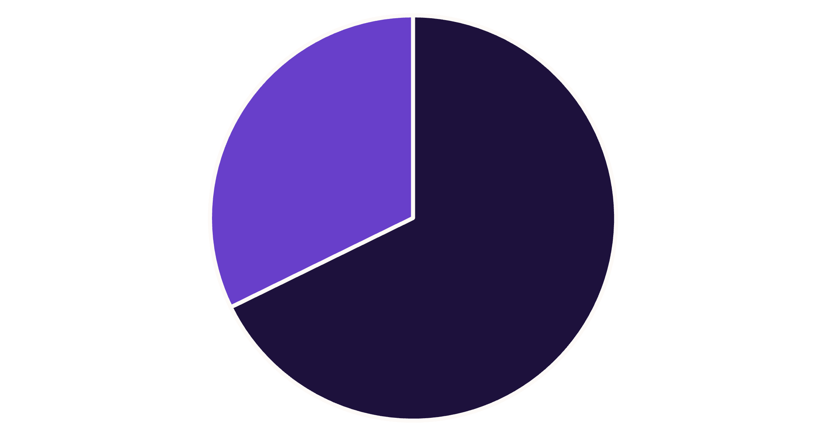
Revenue Insights by Gender
Male Customers Drive Revenue
Male customers generate 68% of total revenue ($157,890) compared to female customers at 32% ($75,191). This significant disparity suggests opportunities for targeted marketing campaigns to increase female customer engagement and spending.
Male
Female

Slide 6
Customer Segmentation Analysis
Three Distinct Customer Groups
Classification based on purchase history reveals customer loyalty patterns:
Loyal
Returning
New
3,116 customers (80%)
701 customers (18%)
83 customers (2%)

Slide 7



CUSTOMER SEGMENTATION ANALYSIS
Customer Loyalty Pyramid
Understanding the structure of our customer base is crucial for targeted marketing and retention strategies.
New Customers
1
2% (83 customers)
Returning Customers
2
18% (701 customers)
Loyal Customers
3
80% (3,116 customers)
This pyramid visually represents our customer segments, highlighting that Loyal customers form the vast majority of our base, providing a stable foundation for growth. Strategies should focus on converting New customers and retaining Returning customers to strengthen this structure.

Slide 8
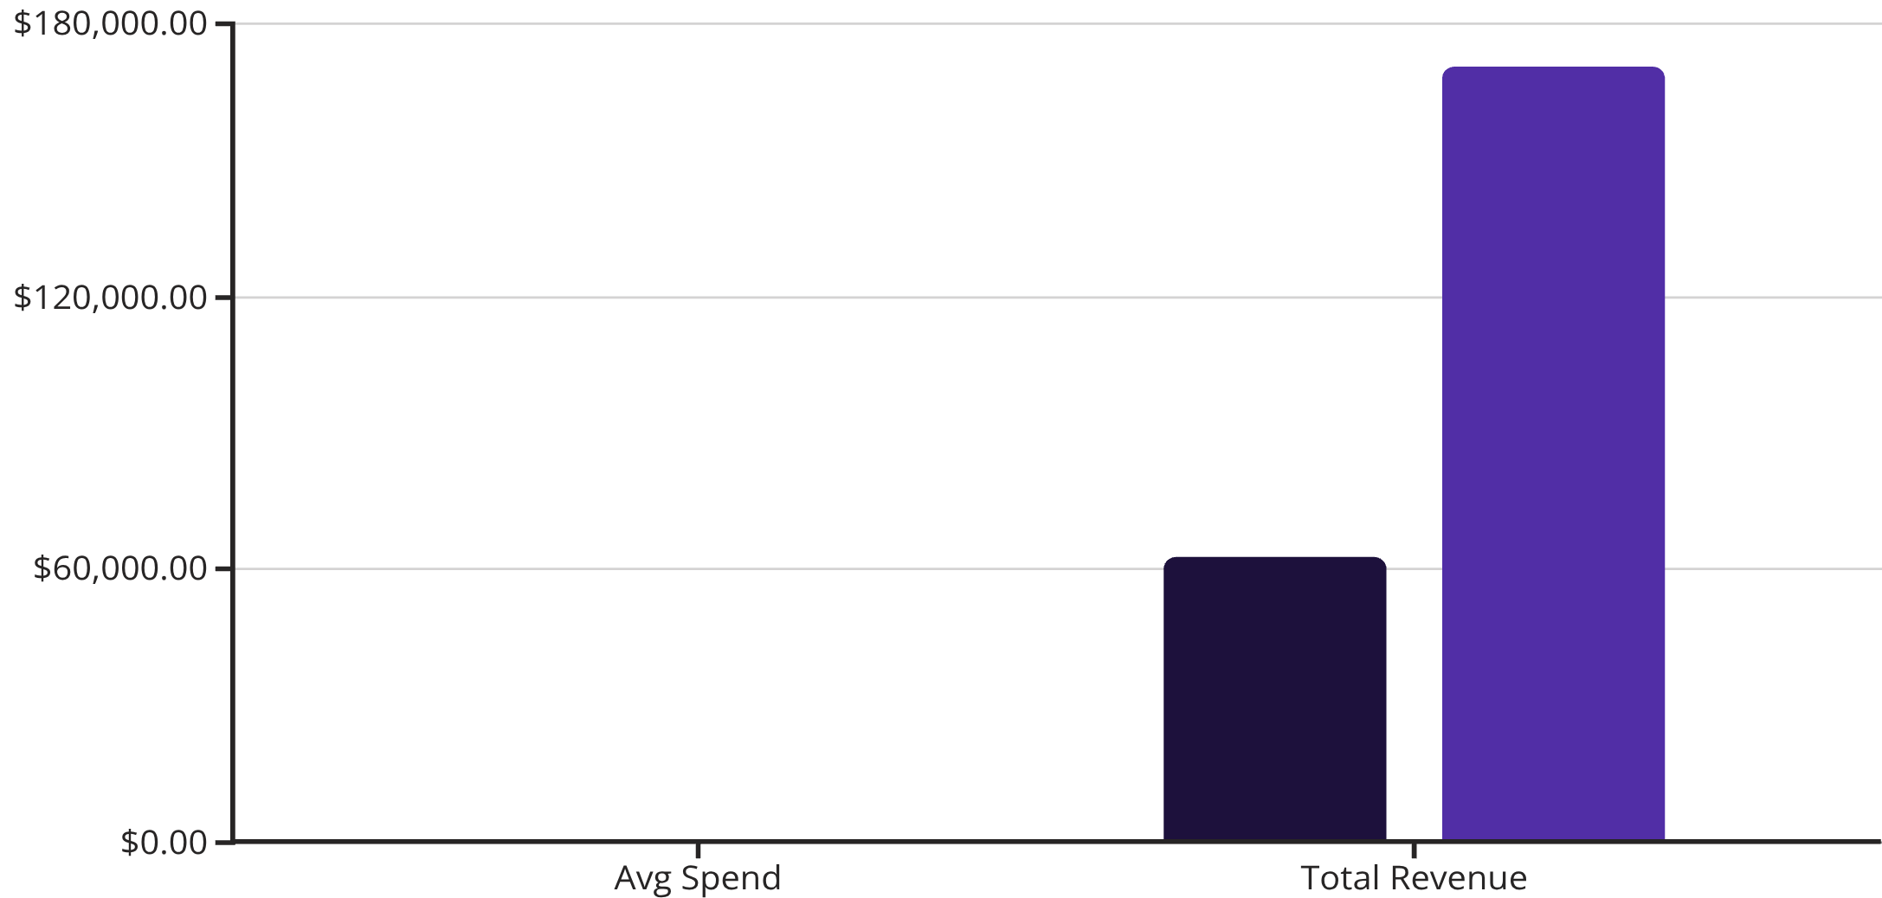
Subscription Status Impact
Untapped Subscription Potential
Only 27% of customers subscribe, yet they contribute significantly to revenue. Average spend is nearly identical ($59.49 vs $59.87), but the 73% non-subscriber base represents major growth opportunity.
Among repeat buyers (5+ purchases), 958 are subscribers while 2,518 are not—clear conversion potential.
Subscribers
Non-Subscribers

Slide 9
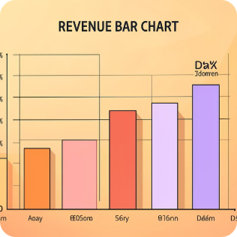
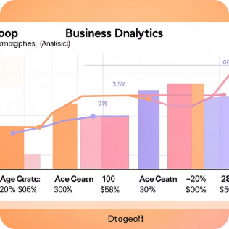
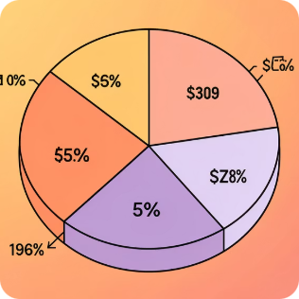
PHASE 3
Power BI Dashboard
Revenue by Category
Age Group Analysis
Key Metrics Display
Clothing leads at $100K, followed by Accessories ($70K)
Young Adults generate highest revenue at $62K
Average purchase $59.76, review rating 3.75 stars

Slide 10
Top Product Insights
Highest-Rated Products
77%
77%
76%
Gloves
Sandals
Boots
3.86 average rating
3.84 average rating
3.82 average rating
Discount-Dependent Products
Products with highest percentage of discounted purchases:
Hat: 50% discount rate
Sneakers: 49.66%
Coat: 49.07%
Sweater: 48.17%
839 customers used discounts but still spent above average—smart shoppers seeking value.

Slide 11

Strategic Recommendations
Boost Subscriptions
Loyalty Programs
Review Discount Policy
Product Positioning
Reward repeat buyers to move them into Loyal segment
Promote exclusive benefits to convert the 73% non-subscriber base
Balance sales boosts with margin control on high-discount items
Highlight top-rated products in marketing campaigns
Targeted Marketing
Focus on high-revenue age groups and express-shipping users

